Slide 1



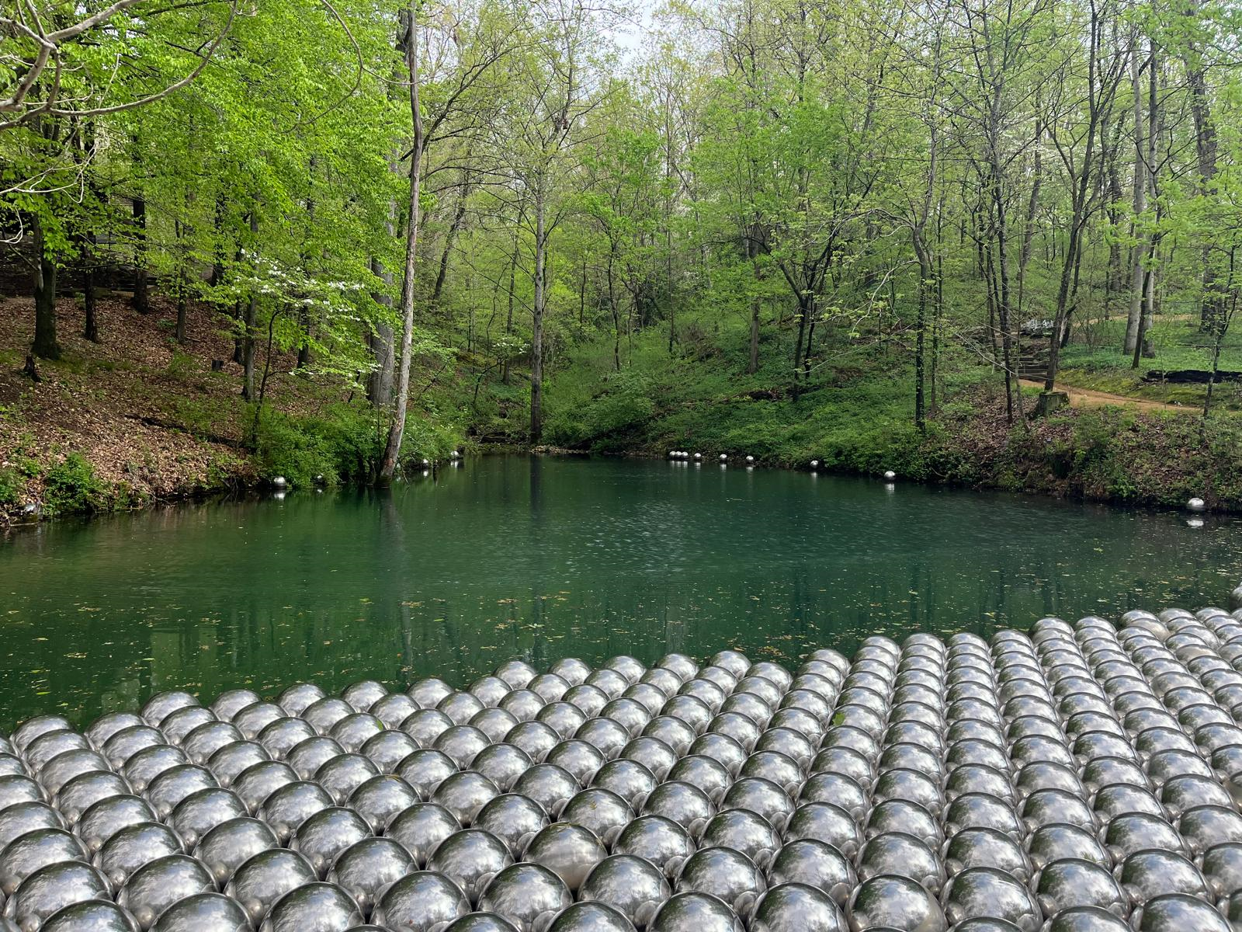
Managing complex water resources systems: The case of agriculture, dams, and water quality Danna Villarreal, MSc
Data Visualization Student Showcase
AGU Headquarters, Washington DC
April 29, 2024

Slide 2
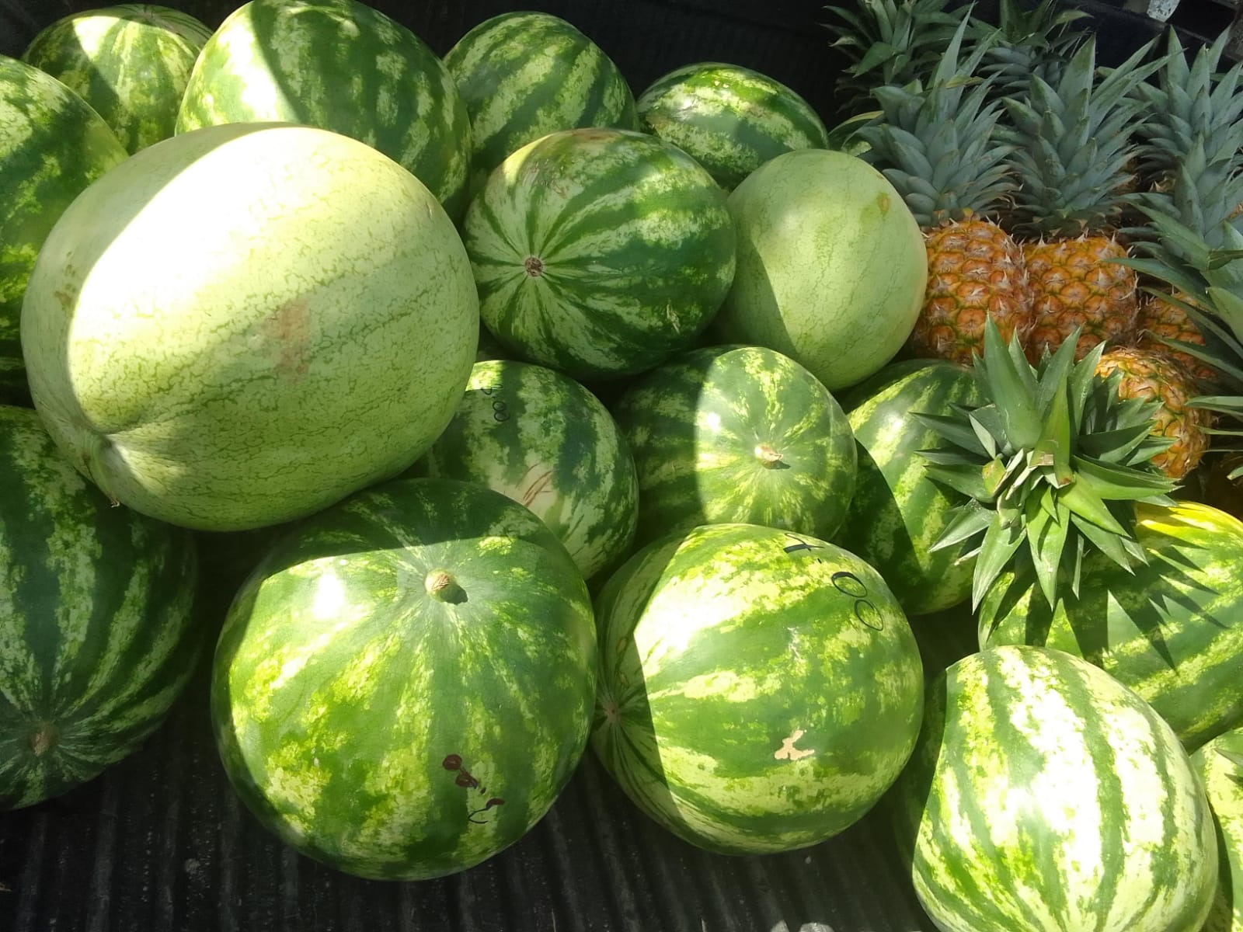



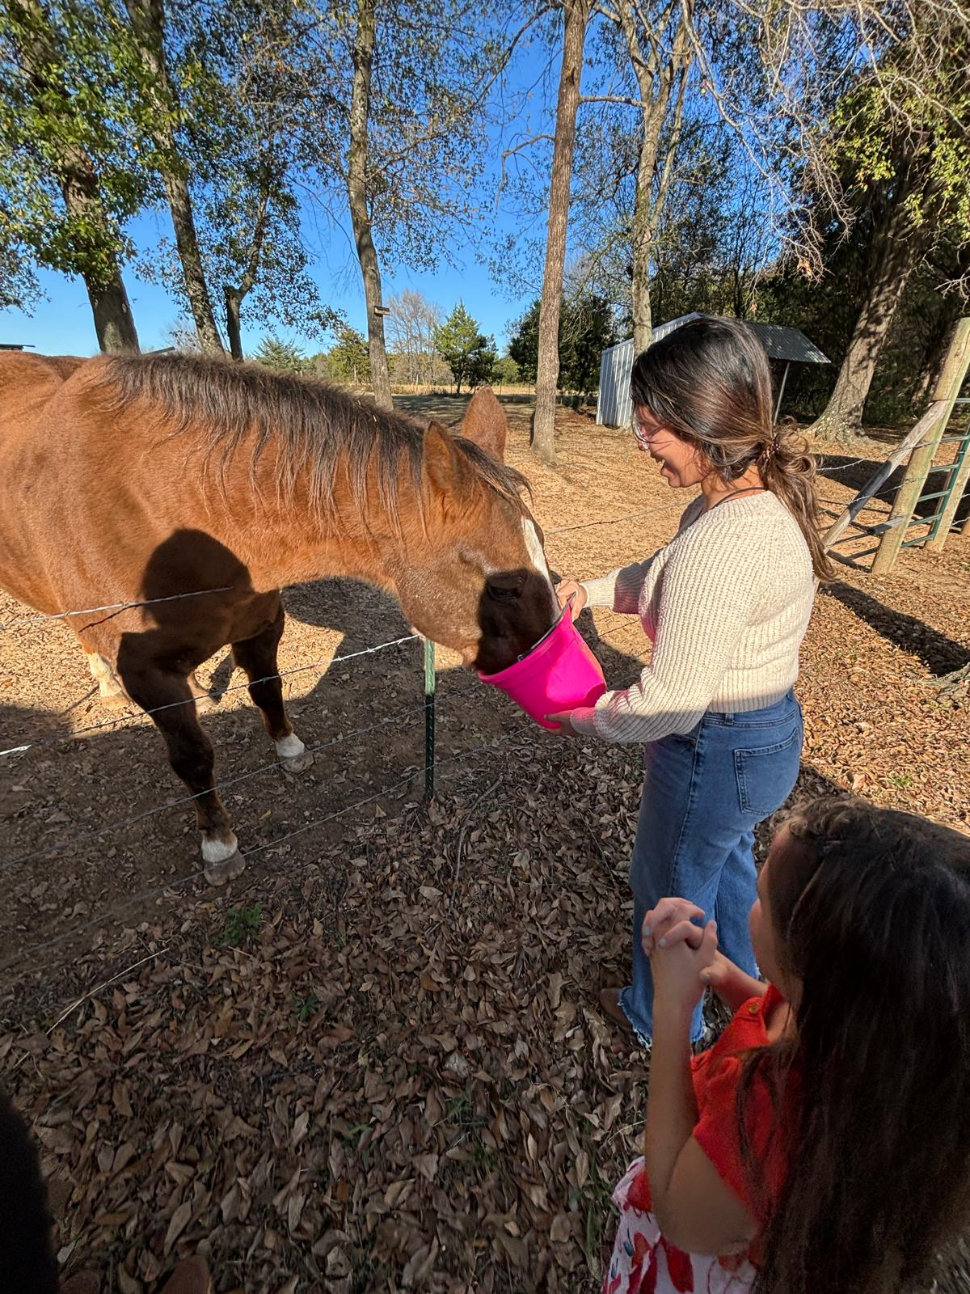
About Me: Danna Villarreal
PhD Student - Biological and Agricultural Engineering, University of Arkansas
Panamanian
Fluent Spanish & English, definitively not German
Extrovert/Introvert
Studied 4 European universities for MSc (ERASMUS MUNDUS)
Guilty pleasure: petting animals and eating watermelons

Slide 3
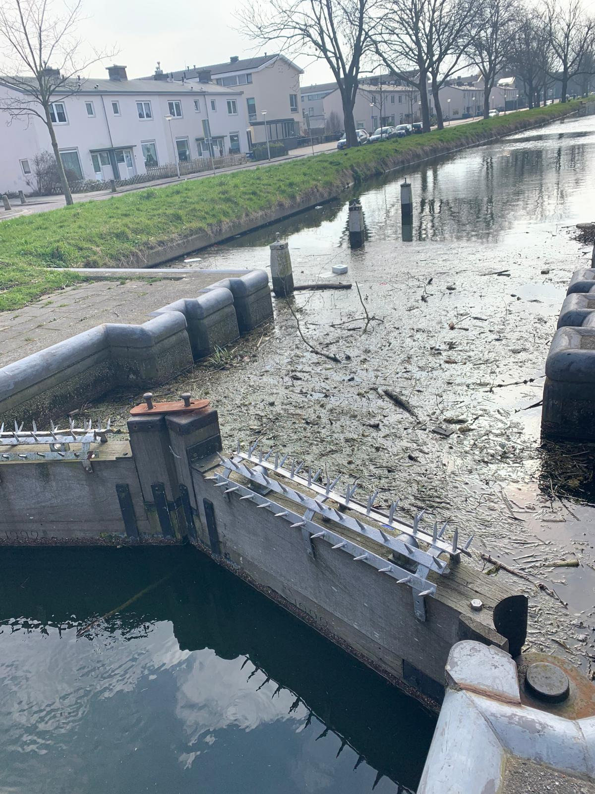
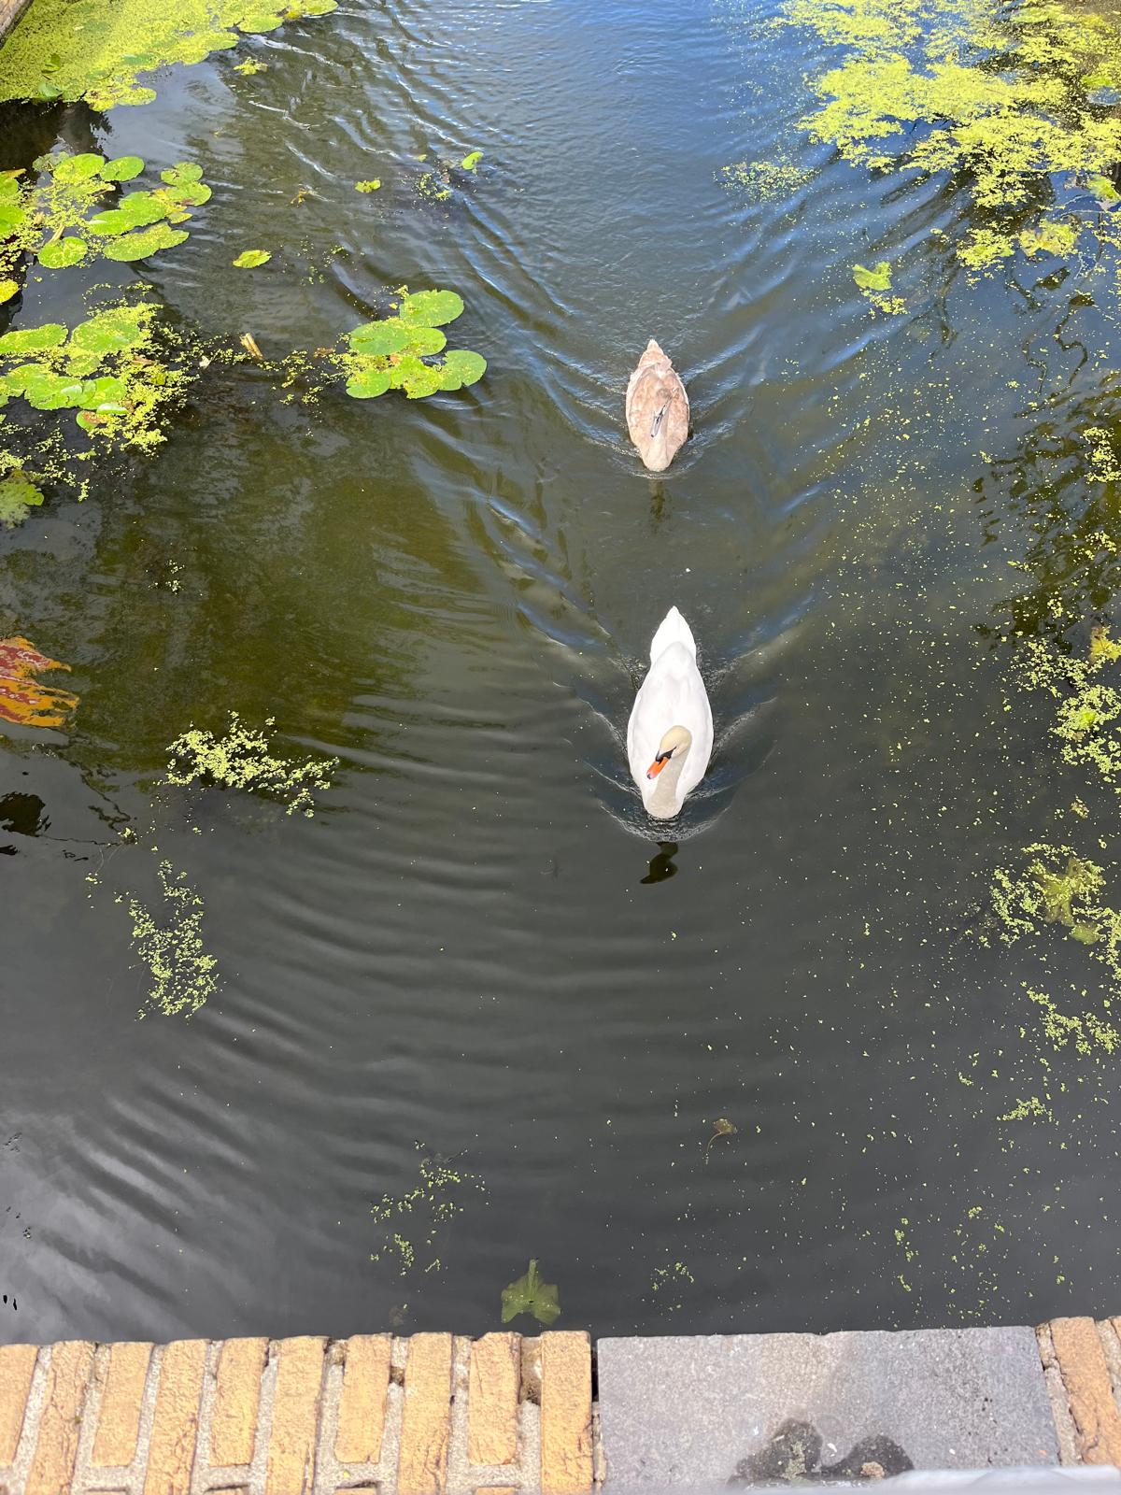

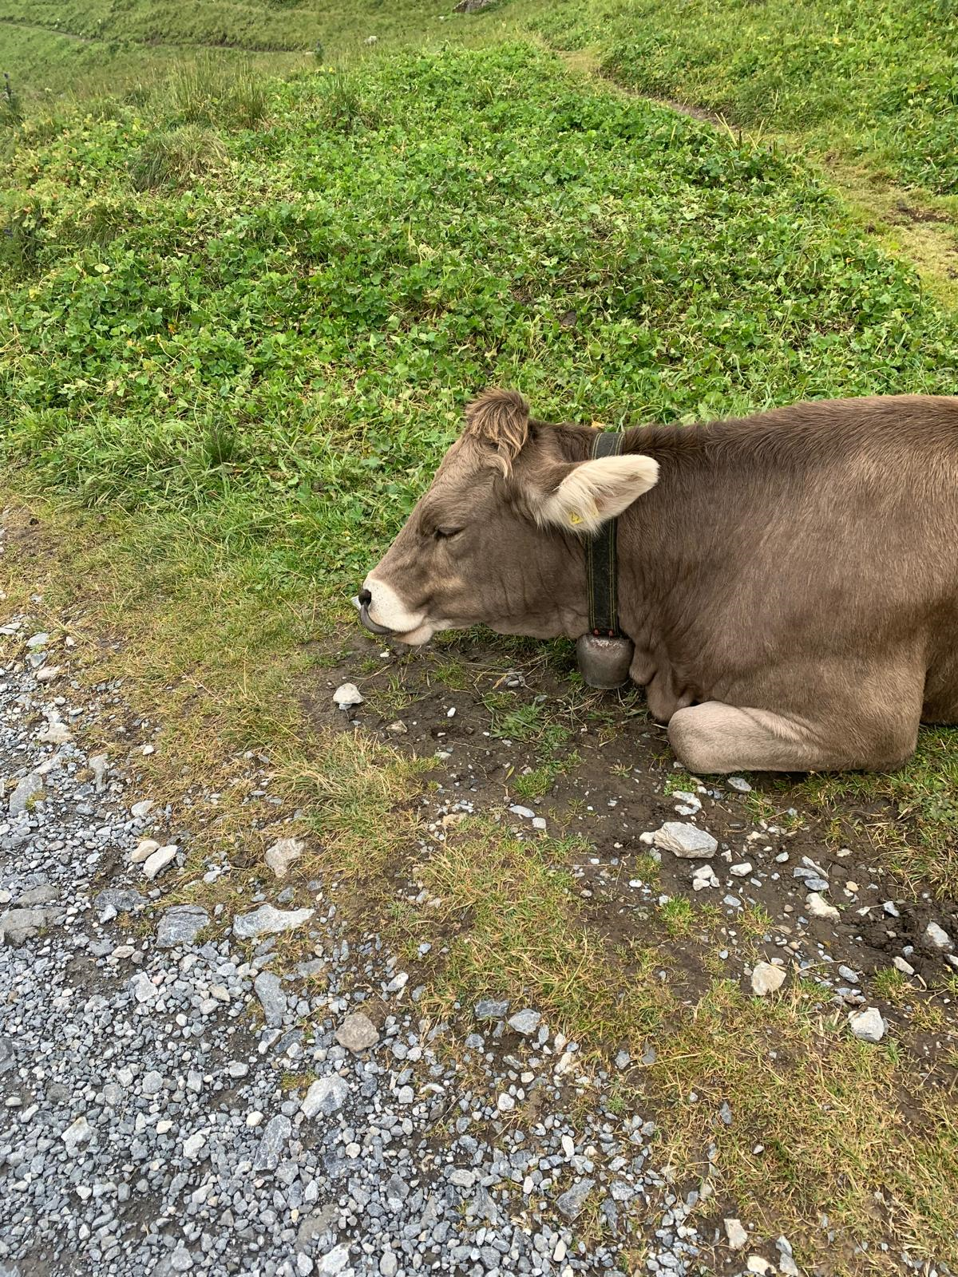
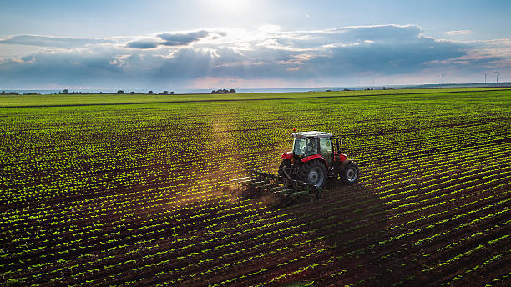
Water Resources Management
Dams
Agriculture
Alter Water Quality
=

Slide 4
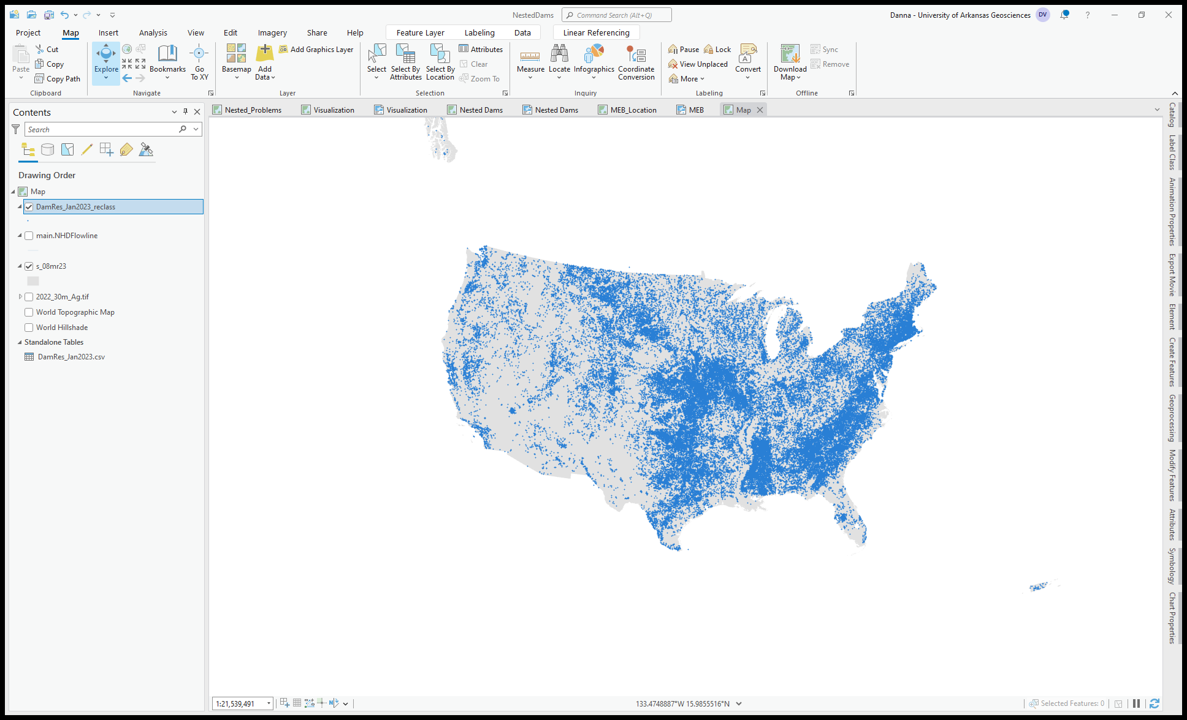
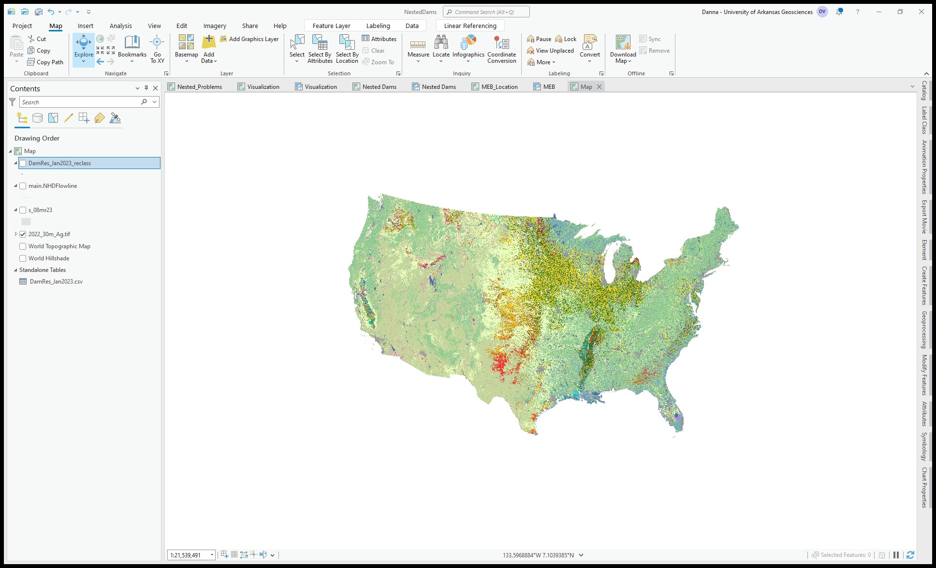
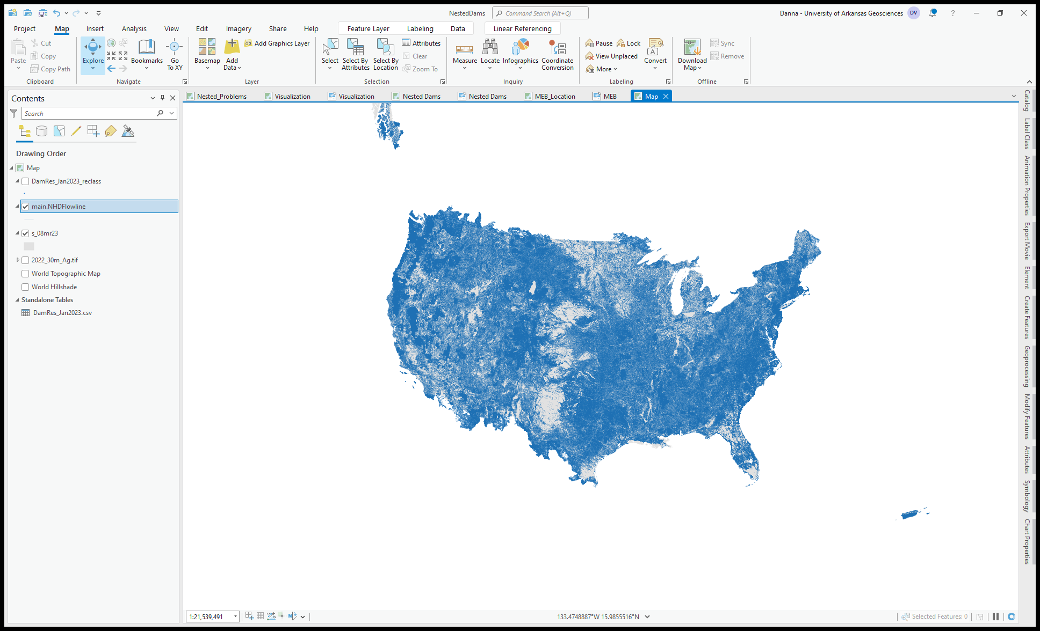
Three public datasets used
National Inventory of Dams (NID)
US Army Corps of Engineering (USACE)
+90k dams with +75 labels
Group categories
Cropdata Layer 2022 (CDL)
US Department of Agriculture (USDA)
129 types of landuse
Reclass for agricultural and no agricultural land use
National Hydrography Dataset + High Resolution (NHD+HR)
US Geological Survey (USGS)
US stream network
No processing

Slide 5
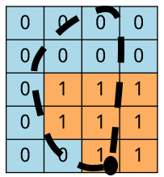
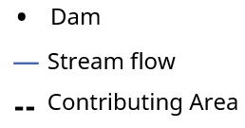
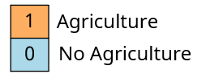
Contributing areas + Agriculture land use
NID location (latitude & longitude)
USGS API – NHD+HR
Contributing Area generation
Quantify agricultural presence in the delineated contributing area
River flow

Slide 6
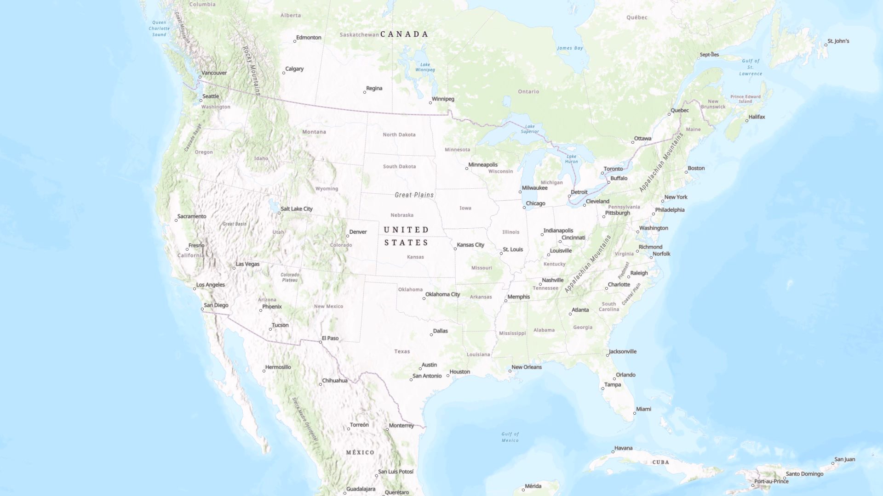
88571 contributing areas are delineated

Slide 7
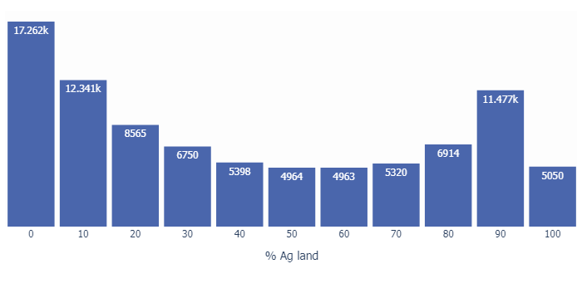
11.5k dams have >90% of agricultural land use in their contributing area
43% of the dams have more than 50% of agriculture land use upstream, equivalent to 763 million acres of contributing areas.

Slide 8
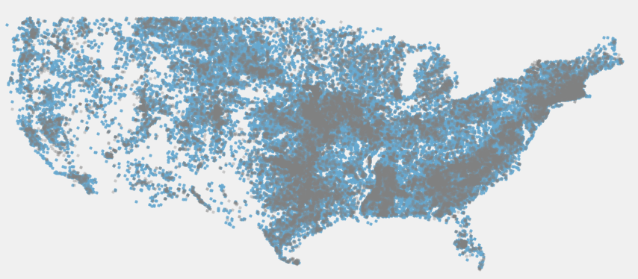
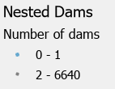
37% of dams are classified as nested dams.
>1
Nested Dams
Less than 1 dam
>1
More than 1 dam
Nested dams are classified as contributing areas with one or more upstream dams.

Slide 9
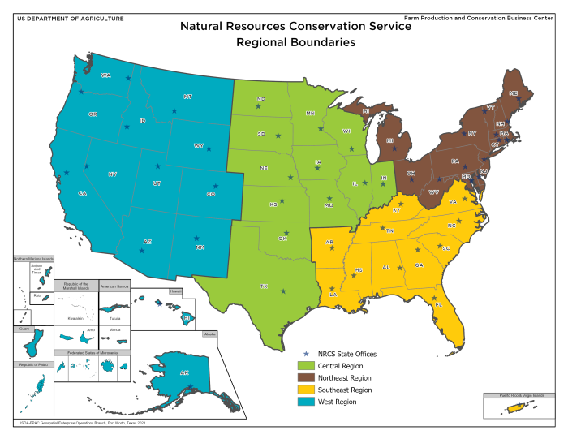
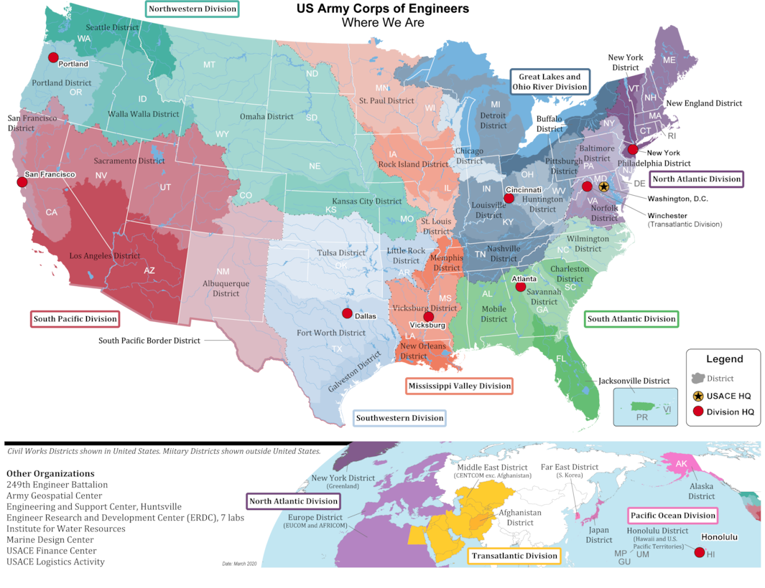
Systems Management
https://www.nwd.usace.army.mil/Media/Images/igphoto/2002469712/
https://www.nrcs.usda.gov/about/leadership

Slide 10

Take away messages
Conclusions
Complex water resources systems occur in the U.S. – 43% of dams in U.S. have more than 50% of contributing area in agriculture
Next Steps
Incorporate water quality (e.g. nitrogen or phosphorus) into analysis
Management of water infrastructure & agriculture is not currently integrated, yet both affect water, especially water quality
Select a smaller region to develop a water quality model (integrating CE-QUAL-W2 and SWAT) to explore combined management scenarios
37% of dams in the U.S. have at least one more dam upstream, adding to complexity
Email: dannav@uark.edu Website: muenichlab.com
This work was supported by the US Army Corps of Engineers Engineering With Nature Initiative through Cooperative Ecosystem Studies Unit Agreement #W912HZ-21-2-0040.

